Slide 1
NFT Token gate

Slide 2


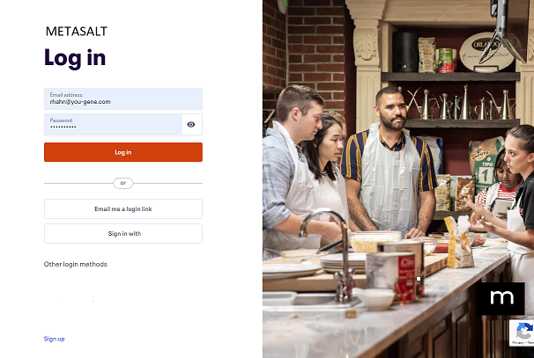
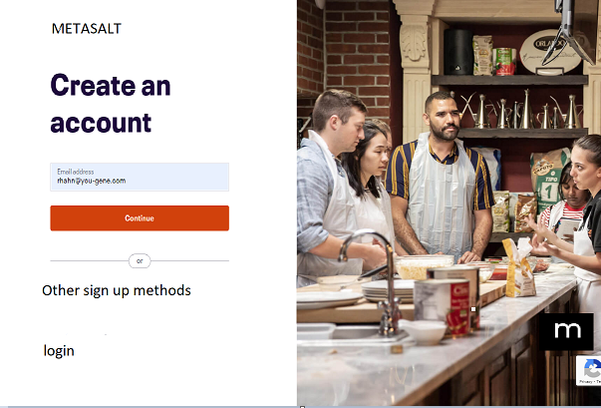
Search NFT gates …
+ CREATE NFT
+ CREATE NFT GATE
BUY/SELL NFTs
LOGIN
SIGNUP
If not logged in
If not logged in
Menu bar BEFORE LOGIN

Slide 3
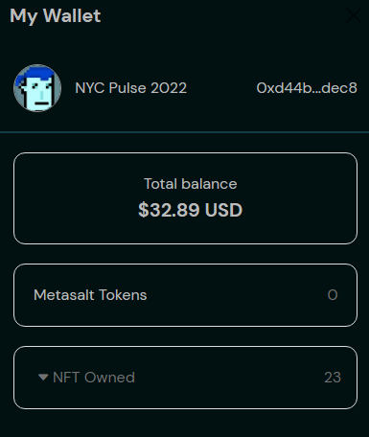
Search NFT gates …
+ CREATE NFT
+ CREATE NFT GATE
+BUY $METASALT
BUY/SELL NFTs
PROFILE
MY NFTS
All
Brands
Collections
Authenticate
My NFT Gates
My Market
My Brands
My Collections
My History
My Settings
Logout
My NFTs
Search box is same
But now searching NFT GATES
Remove menu
Just need a + sign that redirects to Create NFT page
No Brand and Collections submenu. These items will be in flow
New NFT Gate
Just a “+” sign
Redirects to new create NFT Gate page
Just a “+” sign
No button
Redirects to “Trade
$Metasat” token page
Links to entire marketplace
Links to marketplace filtered just on brands
Links to marketplace filtered just on collections from all brands
*Ranking and Social can stay just on home page w/no menu
Add “My NFT Gates"
Stays same, but change “My Wallet” to “My NFTs”
Menu bar AFTER LOGIN
DOCS
Move Docs Button to footer

Slide 4
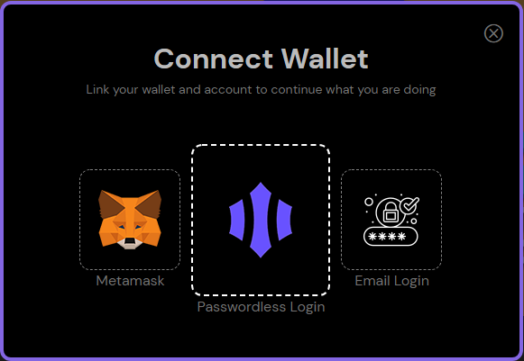
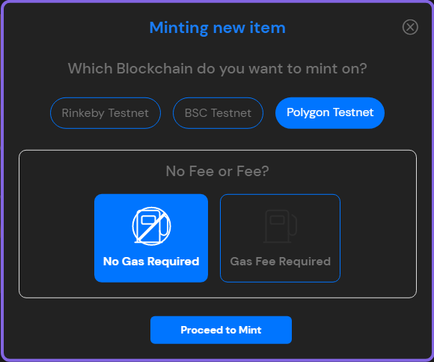
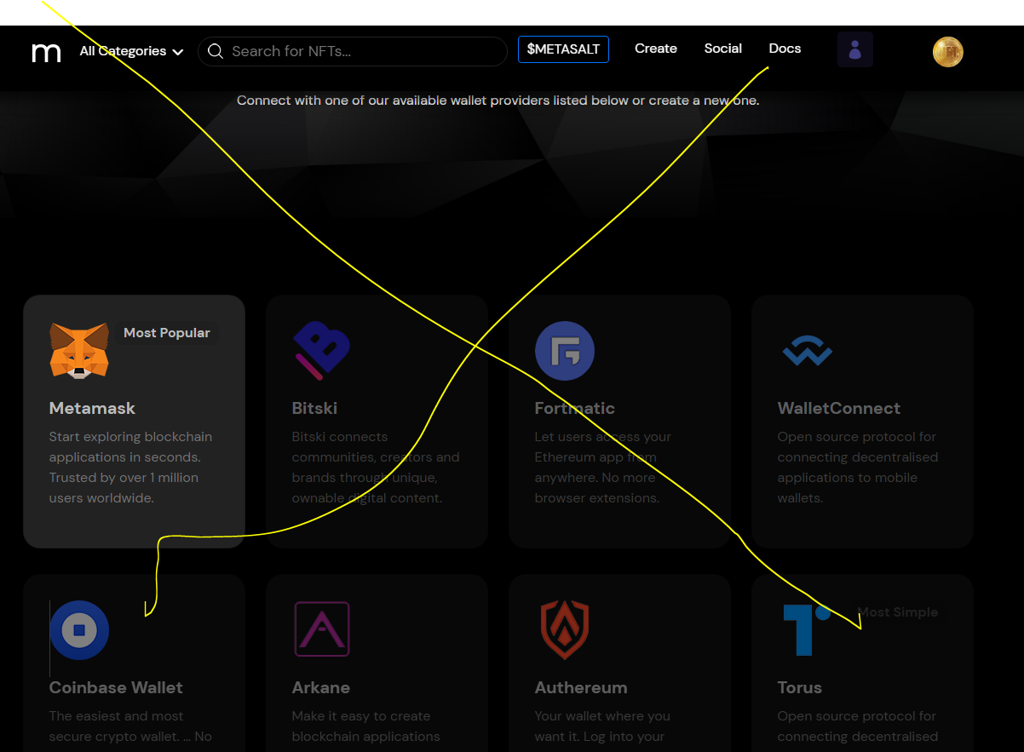
Search NFT gates …
+ CREATE NFT
+ CREATE NFT GATE
+BUY $METASALT
BUY/SELL NFTs
PROFILE
MY NFTS
If passwordless, check if wallet address is in db
Delete this page
Check if wallet address is in db
If not, popup saying “you can browse and use all features.
However, to buy/sell and create, you must create Metamask
Links

Slide 5
Search NFT gates …
+ CREATE NFT
+ CREATE NFT GATE
+BUY $METASALT
BUY/SELL NFTs
PROFILE
MY NFTS

Slide 6
Search NFT gates …
+ CREATE NFT
+ CREATE NFT GATE
+BUY $METASALT
BUY/SELL NFTs
PROFILE
MY NFTS

Slide 7
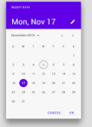
Search NFT gates …
+ CREATE NFT
+ CREATE NFT GATE
+BUY $METASALT
BUY/SELL NFTs
PROFILE
MY NFTS
NFT GATE TYPE
STATUS
Memberships
Events
Media
Products
Draft
Scheduled
Publish
Date Picker
You must finish to publish
You must finish to publish
Details
Details
Details

Slide 8
Search NFT gates …
+ CREATE NFT
+ CREATE NFT GATE
+BUY $METASALT
BUY/SELL NFTs
PROFILE
MY NFTS

Slide 9
Search NFT gates …
+ CREATE NFT
+ CREATE NFT GATE
+BUY $METASALT
BUY/SELL NFTs
PROFILE
MY NFTS

